Slide 1


Introduction to Programming Using Python

Slide 2
What is a Program?
Program is a set of instructions, which takes some input and give a specific output.
These programs are made of statements.
Statements are single line of code which performs a specific task.

Slide 3
Programming Language
There are thousands of programming languages in the world of programming. Some of the most popular ones are listed below:
C
C++
Java
Python

Slide 4
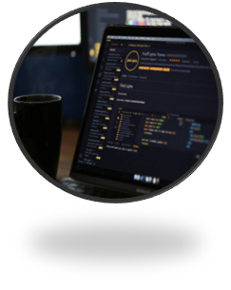
Why Python?
Easy to Use
Simple Syntax
Versatile
Dynamically typed
Multi-paradigm Language

Slide 5
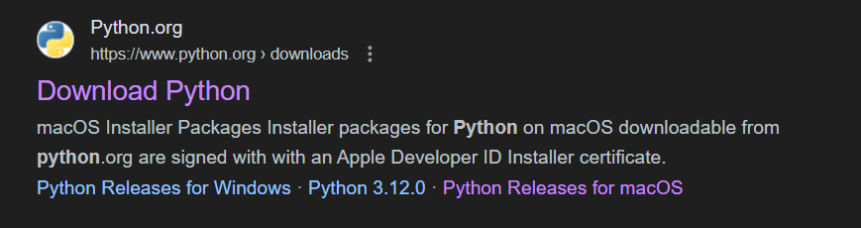
Installing Python
Installing Python with IDLE:
Step 1: Go to Safari and search "Download Python".
Step 2: Click on the first link, See Screenshot:

Slide 6
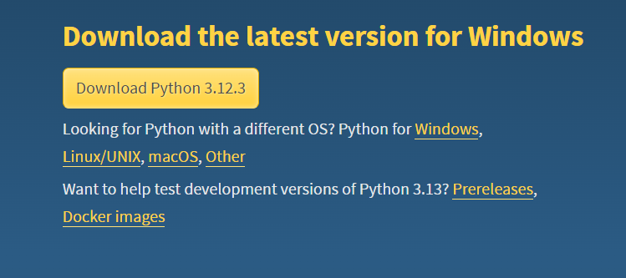
Installing Python
Step 3: Click on the Download button, see screenshot:
Step 4: Install the Downloaded package.

Slide 7
Installing Python using apt
Step 1: Update your apt repository
$ sudo apt update
Step 2: Install python3 package
$ sudo apt install python3
Step 3: Verify using python3 command
$ python3 --version

Slide 8
Using Python IDLE
What is Python IDLE?
IDLE stands for Integrated Development and Learning Environment. It was developed to make learning python easy and fun.
Two modes of Python IDLE:
Interactive Mode
Script Mode

Slide 9
Interactive Mode
Advantages:
Interactive in nature
Show the output for a single-line program right after it.
Disadvantages:
Cannot be used for multiline programs

Slide 10
Script Mode
Advantages:
Can be used for multiline programs
Helps us organize contents in a file
Disadvantages:
Does not display output automatically

Slide 11
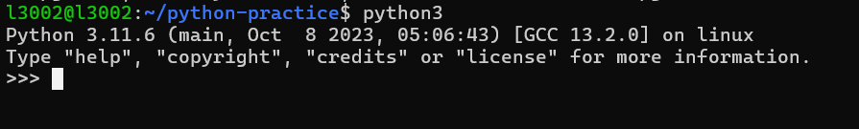
Using Python through terminal
To open script mode:
$ python3

Slide 12
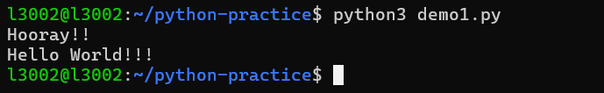
Executing Python Files
Step 1: Create a file using any text editor (ex. nano)
Remember to add a .py extension after filename
Step 2: Save the file.
Step 3: Use python3 command to run it.

Slide 13
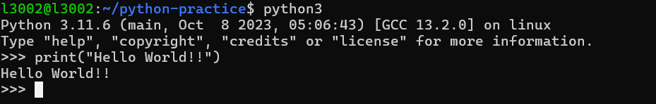

First Program in Python
Write "Hello World" on the command line or IDLE output space.

Slide 14
Demystifying print()
Functions are set of statements which perform a particular task.
Arguments are values passed to a function.
print() function:
The print() function is used to print stuff on the terminal or on a buffer.
It doesn't require any arguments, but can take up to 4 arguments.

Slide 15
Escape Sequences
Escape sequences are special characters which cannot be used in a string normally.
These characters need to be escaped using a special notation in string.
Example:
\n new line character
\t tab character
\' Single quote character
\" Double quote character

Slide 16
Tokens
Identifiers – These are used for naming things
Literals – These are values which are assigned to variables. These are fixed.
Keywords – These are words reserved in python. They have a special meaning.
Delimiters – These are used for separating values and enclosing some values for proper functioning.
Operators – These are symbols which perform some operation on single or multiple operands.

Slide 17
Operators
Operators are used to perform a specific operation on two or more operand.
Below are a few operators in Python:
Arithmetic Operators + , - , / , // , % , * , **
Logical Operators and , or, not
Relational Operator < , > , <= , >= , != , ==
Assignment Operator = , += , -= , /= , %=

Slide 18
Variables & Identifiers
Variable are containers which can store literal values inside of it.
Identifiers are variable names.
The following convention is used for python identifiers:
It should not be a keyword
It should start with a character
It can contain numbers and _
It cannot contain any special characters.

